Slide 1
PROJECT 11
Enhancing The Physical Security System of The Company’s Access Control Using RFID
Dividing into two aspects: Human and equipment access control
Cheongjun Kim
Jaehyun Shin
Myoungjin Oh
Sangyeop Park
Seunghyeon Lee
Uichan Kim
Zhongyuan Hu
Notes:
Hello. I’m Cheongjun Kim, the presenter of project 11.
The subject of our project is "Enhancing The Physical Security System of The Company’s Access Control Using RFID".
The 7 people below are our team members.

Slide 2
Contents
1. Project Goal
2. How the System Works
3. Demonstration
4. Current Problem and Improvement Plan of Project
Notes:
This is a table of contents.
The presentation will proceed in this order.

Slide 3
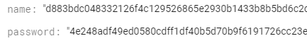
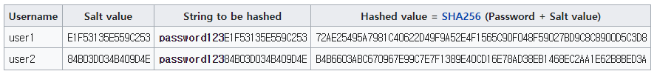
1. Project Goal
“Security”
Notes:
The goal of our project is to establish access control system using RFID.
Company's access control system is a means of improving security. Therefore, the most important goal is "security." Not only do we use RFID system to increase company security, but we also have defense against attacks that can occur in the process of information in RFID system.
We applied the cryptographic hash function "SHA3" to protect privacy information. This hash algorithm is one of the most secure hash functions that currently exist.

Slide 4


1. Project Goal
“Management”
Human
Equipment
Notes:
The second goal is management. Our access control system can be installed in places like gate to perform both human management and equipment management.
In addition, company can use different frequency bands depending on the purpose of use.
It is appropriate to use High Frequency band if company want to use RFID card tag to verify that the person passing gate.
Alternatively, company can use Ultra High Frequency band that can recognize objects from longer distance.

Slide 5





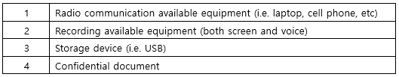
1. Project Goal
“Efficiency”
Notes:
The third goal is efficiency. Our RFID system allows company to effectively distinguish assets by applying "security levels". Security levels distinguish company equipment based on functionality. Security levels do not mean the degree of security strictness.
These are flag for classifying assets within a database.
However, depending on the company, security levels can also be configured with the degree of security strictness. In this case, effective management will be possible depending on the importance of equipment.
Detailed functions of our project will be presented next chapter.

Slide 6
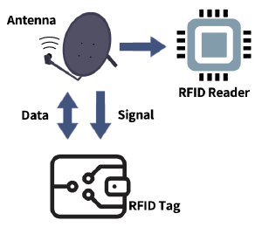





2. How the System Works
Send UID
Console (main.py)
Use hash function to protect information
SHA3-256
Request to view and update information in DB
hash.py
firebase.py
View, modify, and return information in DB
Firebase (cloud firestore)
Notes:
The figure above shows how our system works. RFID tag communicate with reader using antenna.
The reader recognizes tag and gets the information.
Tag’s information is passed to the program and protected by hash function.
Through this process, tag’s information is used in the database as a hash digest.

Slide 7
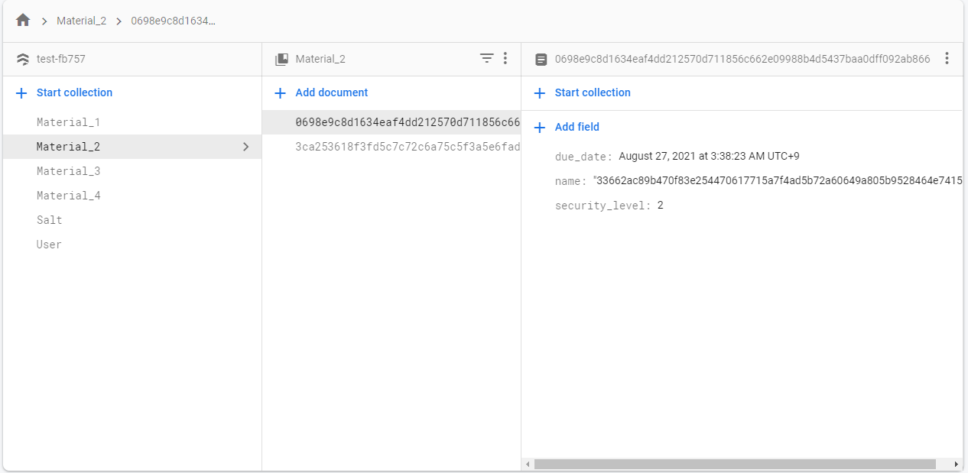

2. How the System Works
Firebase
(cloud firestore)
• Material (1 ~ 4)
• User
• Salt
Notes:
This is the structure of the database. The collection is largely divided into three. Material consists of 1 to 4 depending on the security level. This can be changed depending on the classification of the security level of the company.
"User" is a list of people registered by User management.
This information is stored with a hash function applied.
Salt is a random string to enhance security when processing various information as a hash function. This helps defend Bruteforce or Rainbow Table attacks.

Slide 8
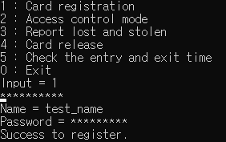
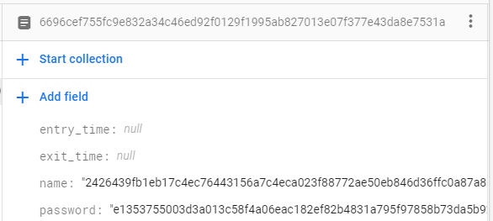
3. Demonstration
Card registration
Notes:
From now on, I will show the operation of the program.
Before the demo video, let me briefly introduce each function.
Let's start with user management.
First function is card registration.
This is a function of User Management that registers user’s card. The user tags the card and enters name and password to register themselves.

Slide 9
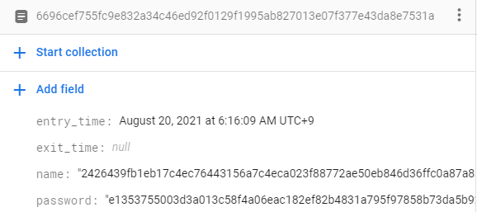
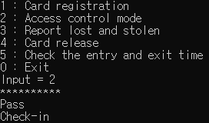
3. Demonstration
Access control
Notes:
Next function is access control.
If people recognize the RFID tag to enter the gate, the entry time is recorded.
If you tag again, the exit_time will be recorded.

Slide 10
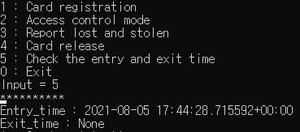
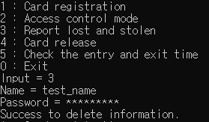
3. Demonstration
Check entry & exit time
Report lost and stolen
Notes:
The admin can check the entry time and exit time for each tag.
In addition, if a tag is reported missing, the system can disable it in the database using the name and password.

Slide 11
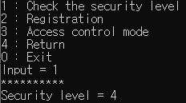
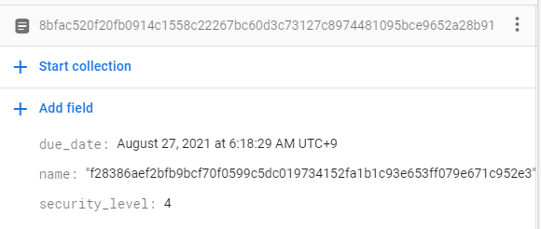
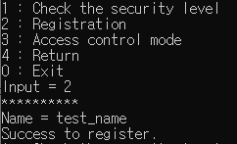
3. Demonstration
Check the security level
Material_4 table
Registration
Notes:
From now on, it's the equipment management part. Each equipment has a security level, which can be checked. And similarly to user management, registration functions exist. The difference is that password information is not included.

Slide 12
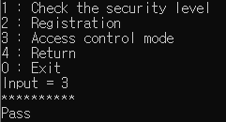
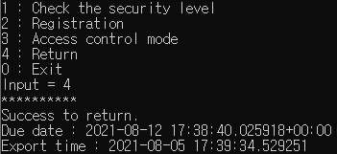
3. Demonstration
Access control
Return equipment
Notes:
This part is related to renting equipment. When someone takes the equipment, they check it, and when they return the equipment, the information in the database is removed.

Slide 13
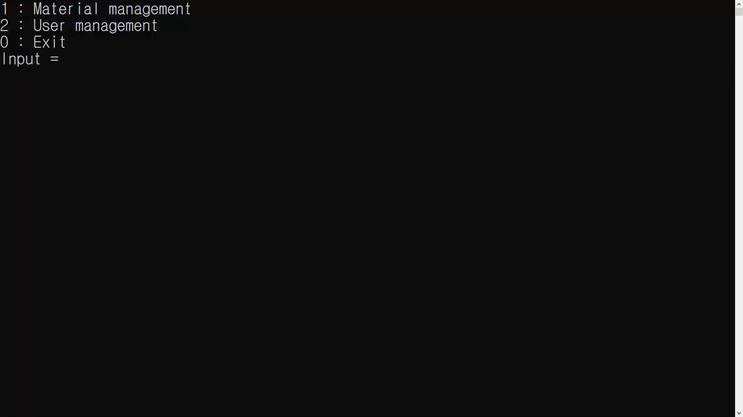
3. Demonstration
Notes:
This is a demo video for actual run.
Some functions were omitted due to the time of presentation.
(Stop)
The 10-digit star shape are masked UID from RFID tag.
The RFID reader actually send 10-digit UID to the system using keyboard emulation method.
The demo shows it as a console, but in company it can be provided with a more improved interface, such as GUI.

Slide 14


4. Current Problem and Improvement Plan of Project
Current Problems
Improvement Plan
Notes:
Next, we will look at the current problems and the plan of solve the problems in our project.
First, finding the UID is time consuming. We applied the hash function to the UID. By the way, we need to compare set of salt values because the database query use UID. In this case, the time complexity can be O(N) in Big O notation.
We can solve this problem simply. The company can use a writable tag in the tag's data area and enter the individual's ID information in that tag.
Then, they can use this ID for database queries instead of UID.
Second, The program only works on Windows operating systems. This is because certain modules are imported for functions that mask input data.
There is also an idea to solve this problem.
If we replace the function that masks the input values with the "getpass" module, our RFID system can also be used by other operating systems such as linux.
With these two improvements, our RFID system will be further enhanced.

Slide 15
Thank you
Q&A
Please feel free to ask question and contact us any time.
Notes:
This is the end of the presentation.
Thank you for listening.

